Slide 1
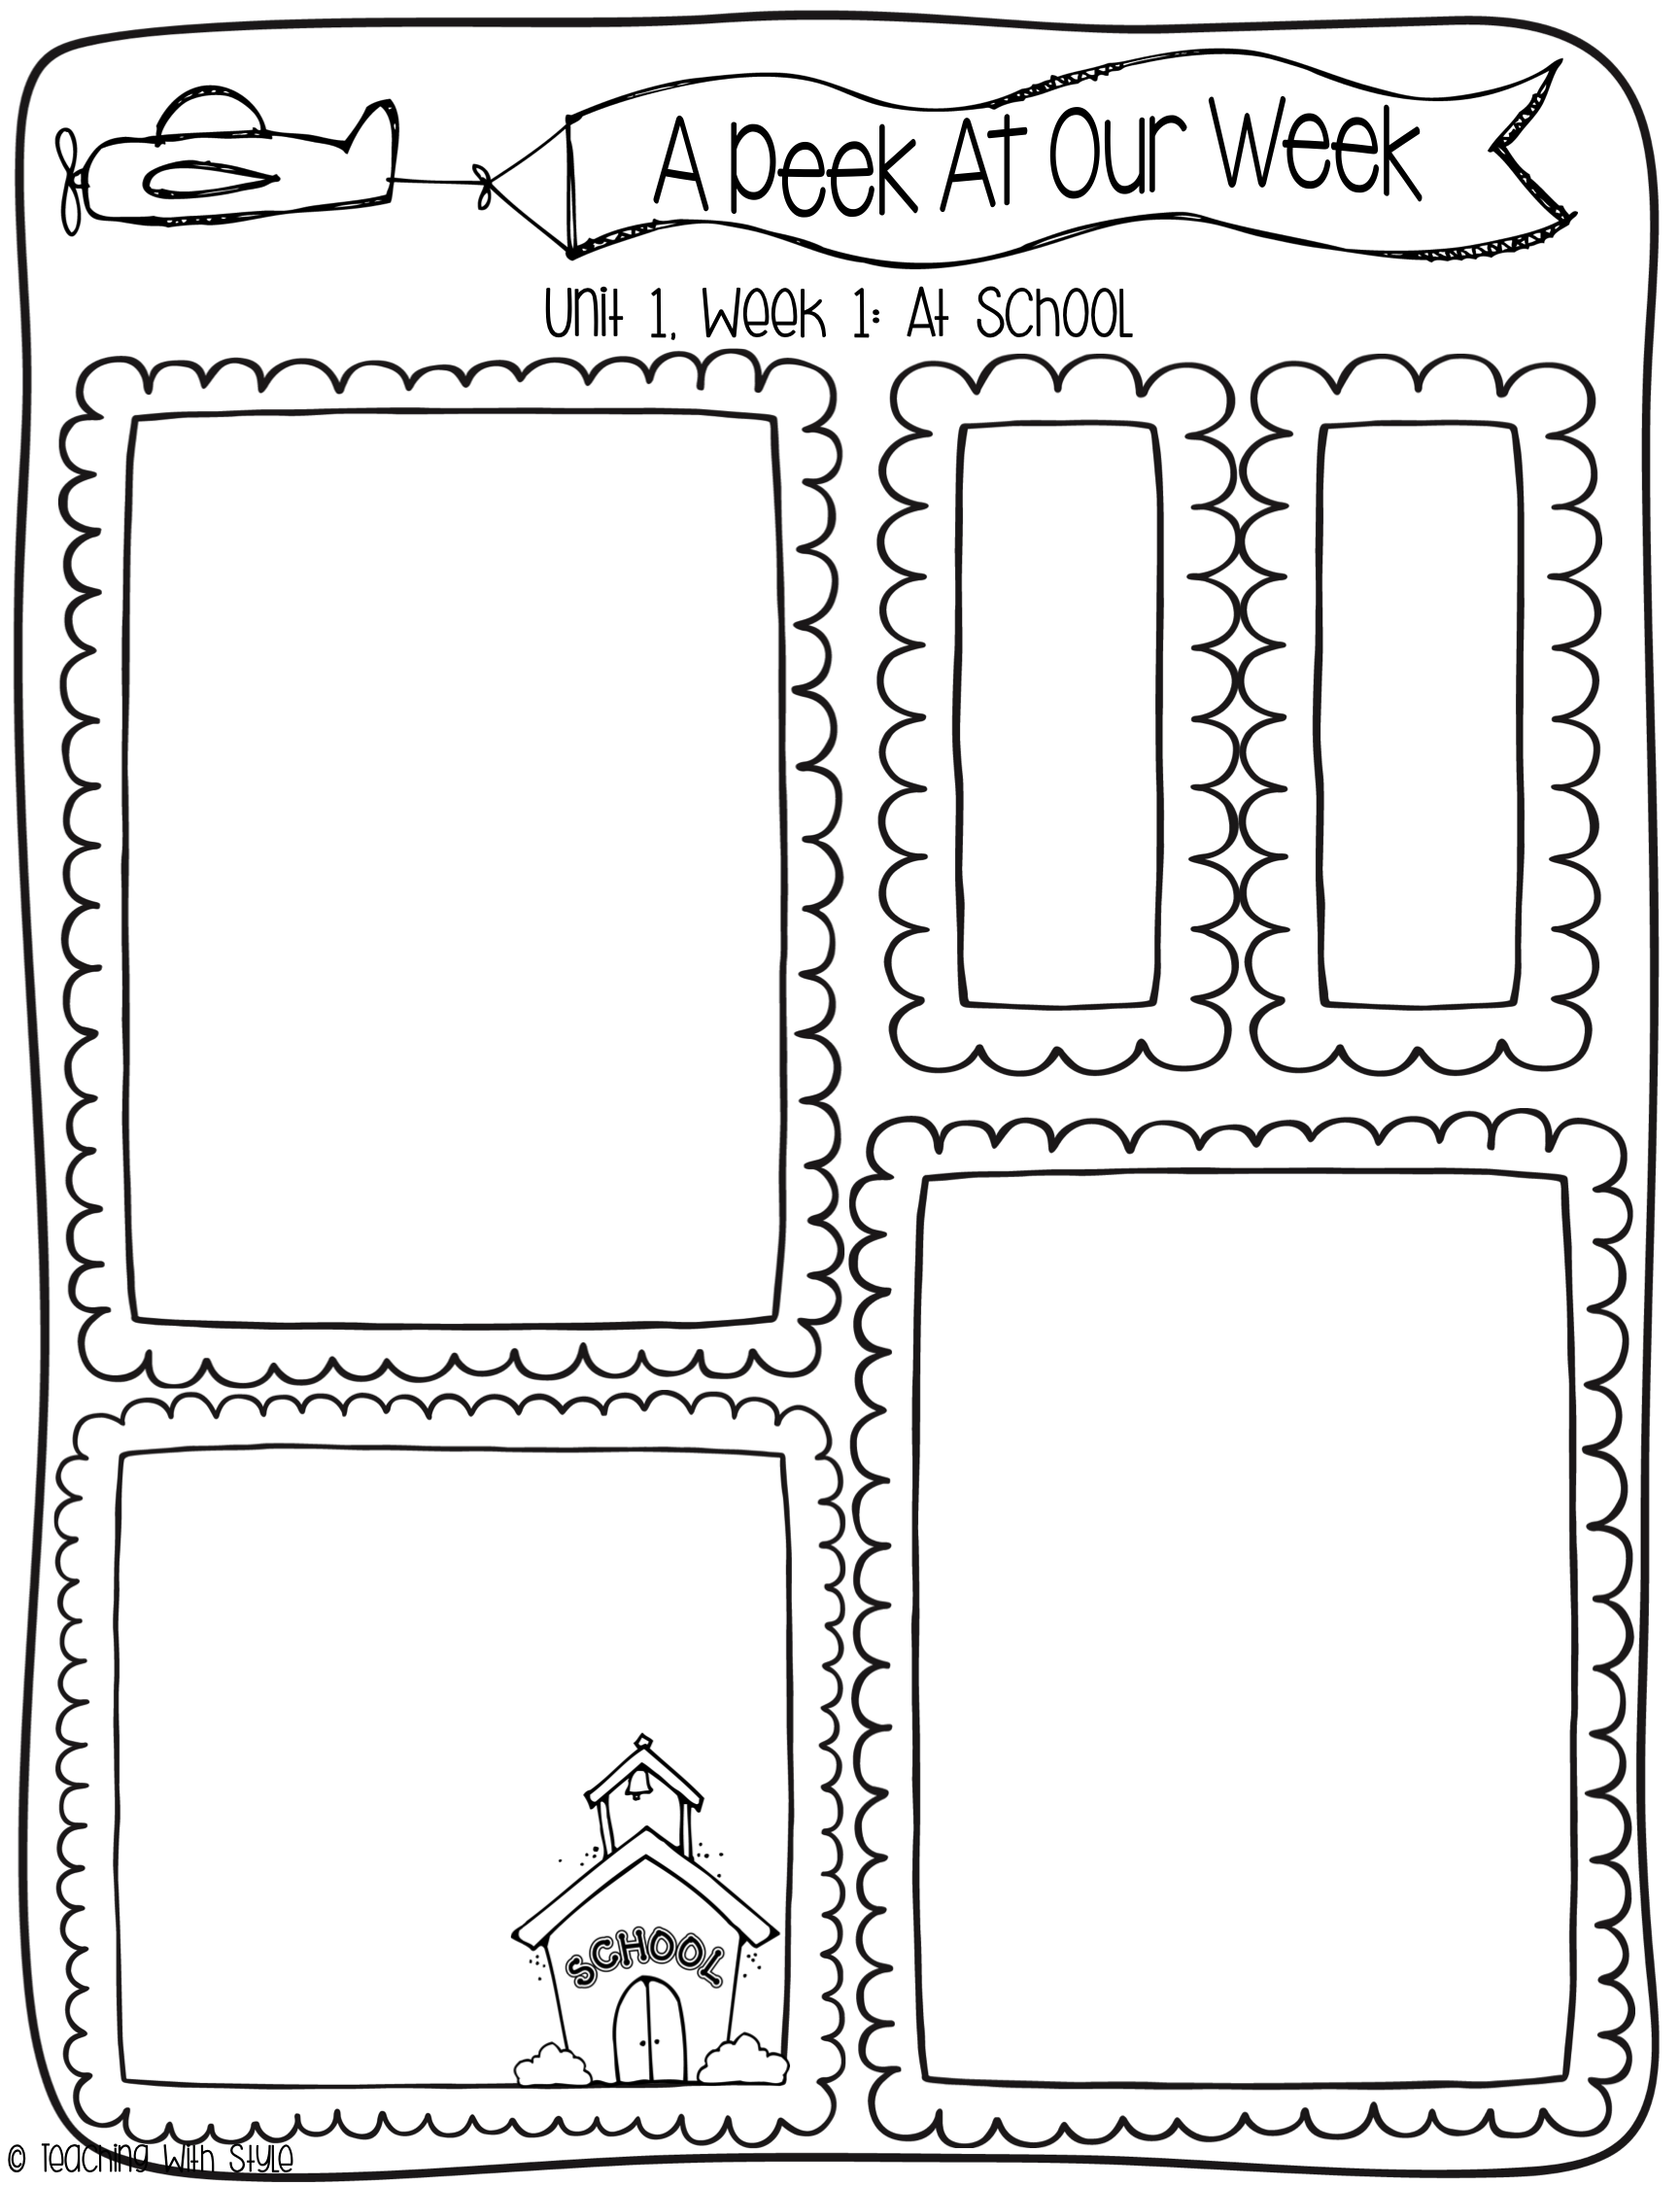
August 18 - 22
What we are learning!
Comprehension Focus:
key details
Word Work:
short a (like in apple)
inflectional ending –s
Grammar:
sentences
Math:
addition
Spelling Patterns
man
can
nap
tap
cat
hat
High
Frequency
Words
does
not
school
what
Dates to remember
August 19th
Chick-fil-A Night
September 1st
Labor Day (NO SCHOOL)
September 7
Grandhawks Picnic (4:00)
September 11th
Parent/teacher Conferences
September 12th
Skate Night
Reminders
*Join Class Dojo
*Donate to the Annual Giving Campaign
*Initial the conduct
sheet EVERY night

Slide 2
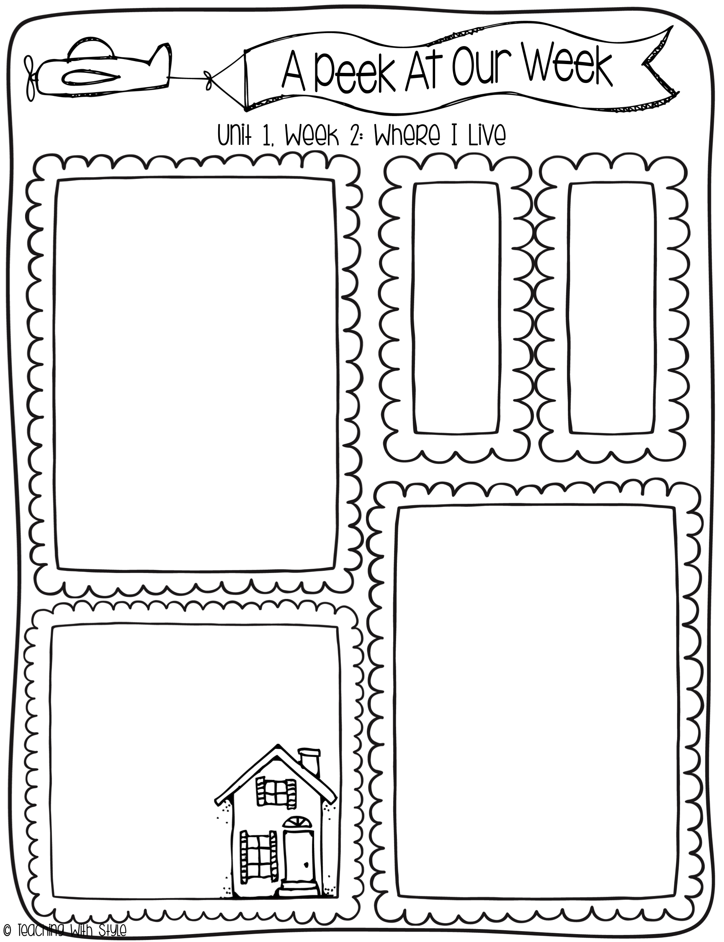
What we are learning!
Essential Question:
What is it like where you live?
Comprehension Focus:
Visualize
Key Details
Word Work:
Short i, the sound in insect
Initial sound alliteration
Double final consonants
Grammar:
Word Order
Writing Trait:
Ideas
Spelling Words
pin
win
hit
sit
miss
kiss
nap
can
out
up
HF
Words
out
down
up
very
Vocabulary Words
city: a large town with tall buildings and many people.
country: the land outside a town or city, where there are farms.
scurried: when you move very quickly.
feast: a big, fancy meal with many different foods.
bored: when you feel like you have nothing to do.
Stories for the Week
Reading/Writing Workshop:
Six Kids
Genre: Fantasy
Literature Anthology:
Go, Pip!
Genre: Fantasy
Big Book:
Alicia’s Happy Day

Slide 3
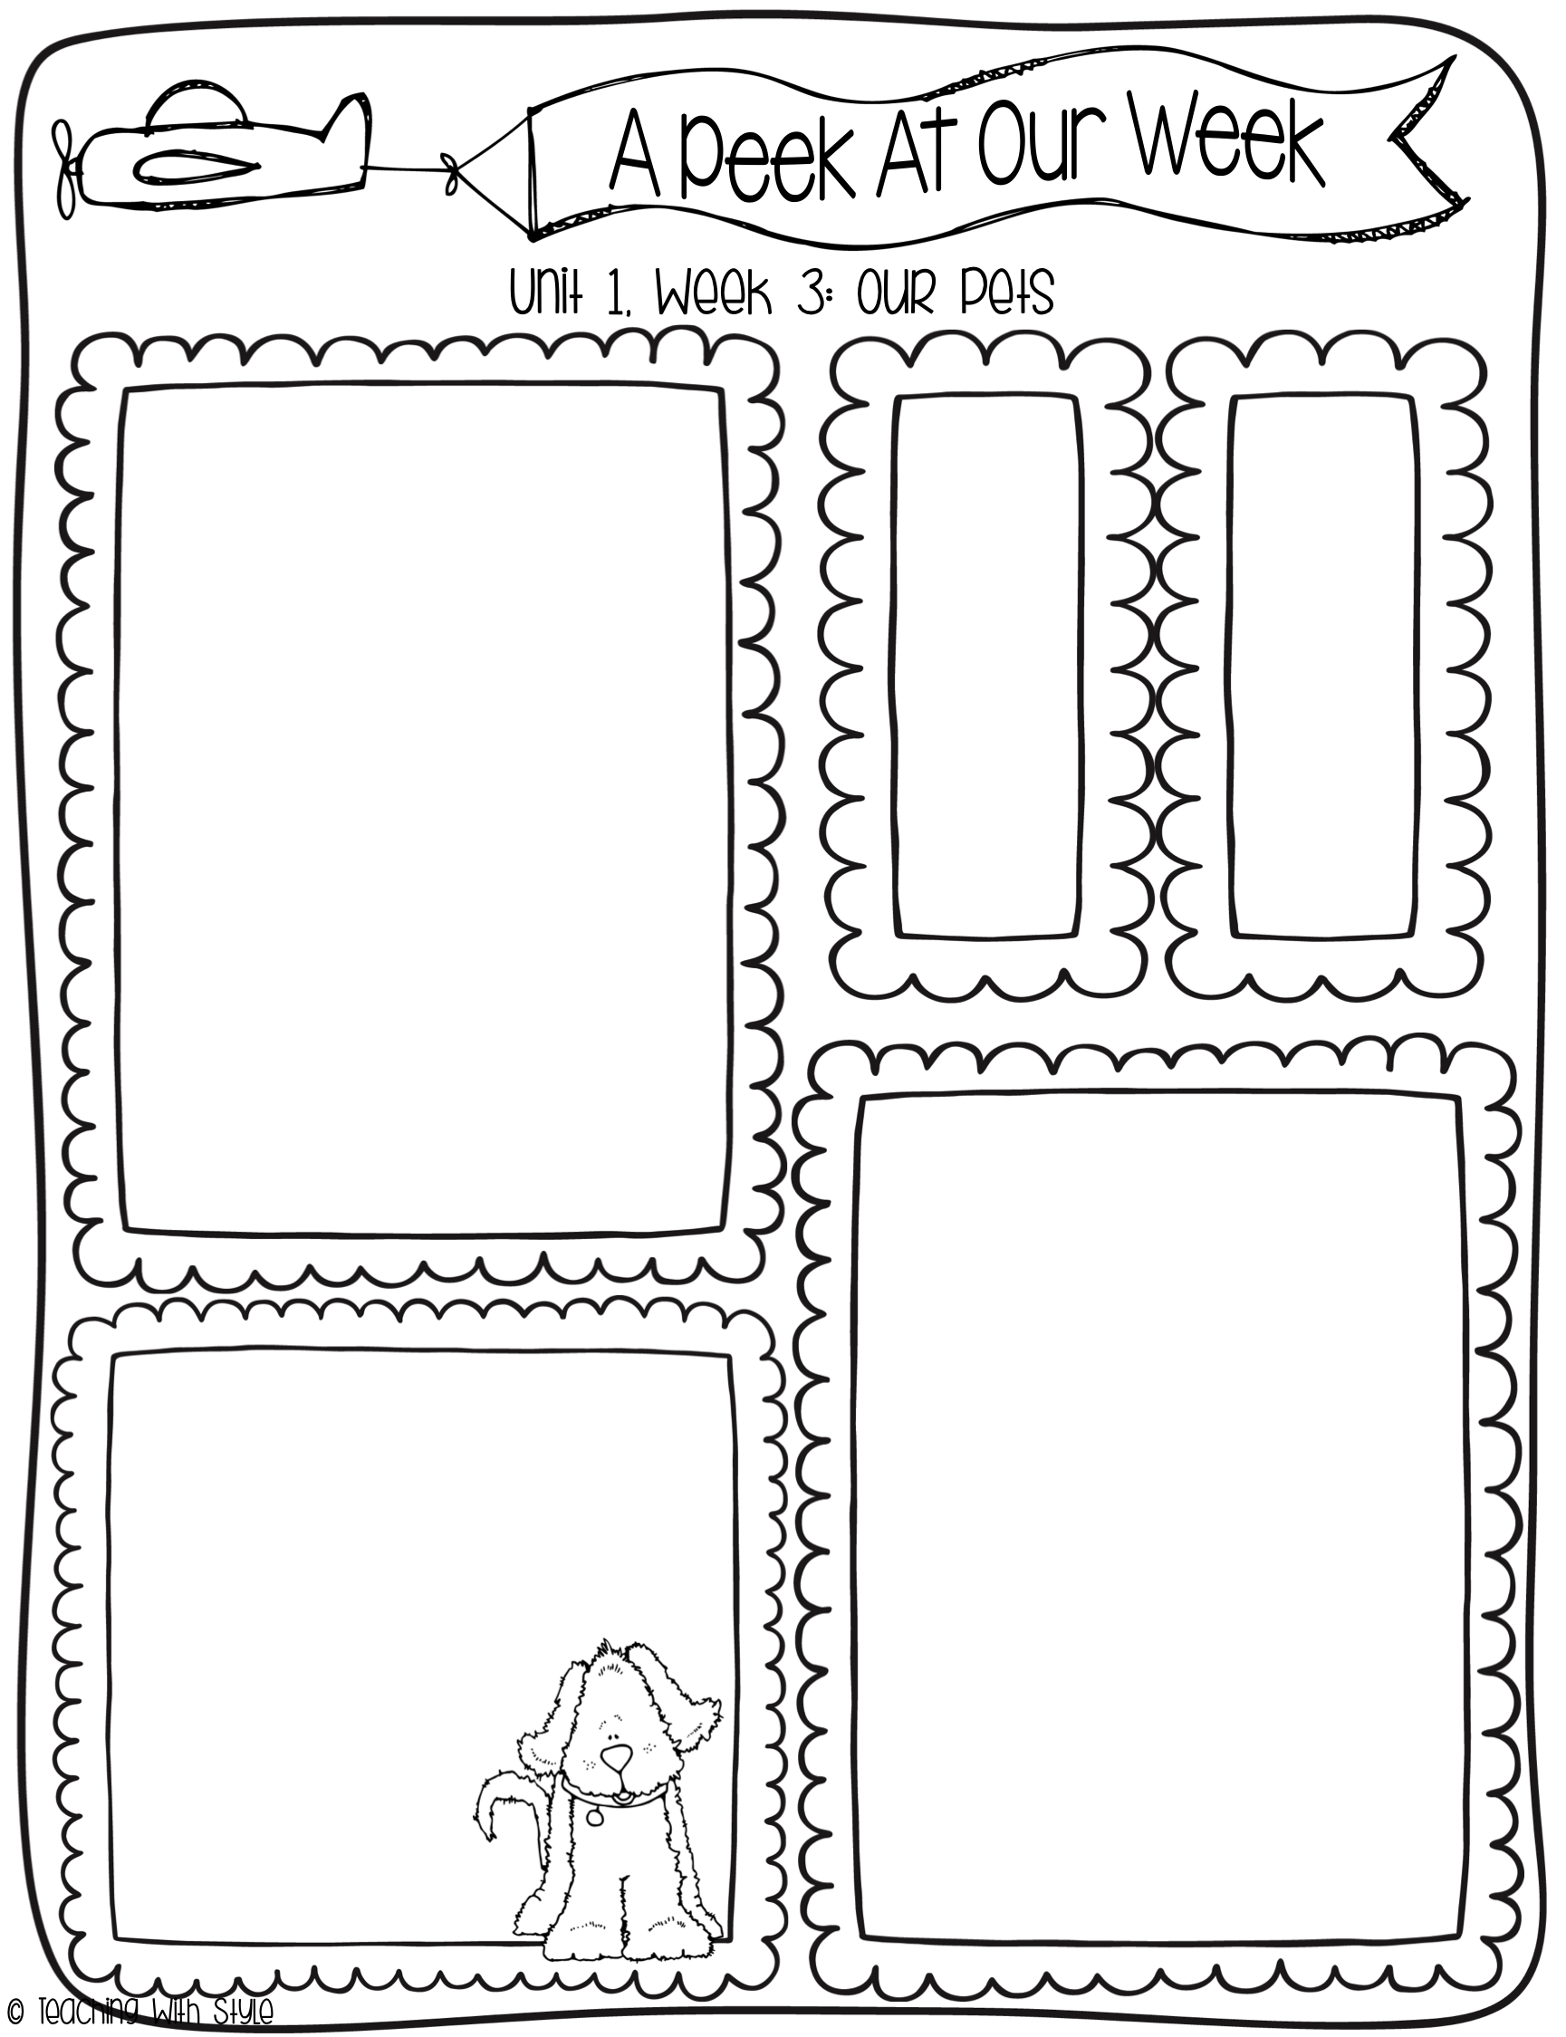
What we are learning!
Essential Question:
What makes a pet special?
Comprehension Focus:
Visualize
Key Details
Word Work:
Contrast vowel sounds
L-blends
Plural nouns
Grammar:
Statements
Writing Trait:
Ideas
Spelling Words
clip
flip
slip
flag
black
plan
win
sit
be
pull
HF
Words
be
come
good
pull
Vocabulary Words
care: giving someone or something it needs to stay healthy and happy.
train: teaching someone or something to do things.
companion: an animal or person that keeps you happy.
groom: when you wash an animal or brush it’s fur.
popular: something that many people enjoy.
Stories for the Week
Reading/Writing Workshop:
A Pig for Cliff
Genre: Fantasy
Literature Anthology:
Flip
Genre: Fantasy
Big Book:
Cool Dog,
School Dog

Slide 4
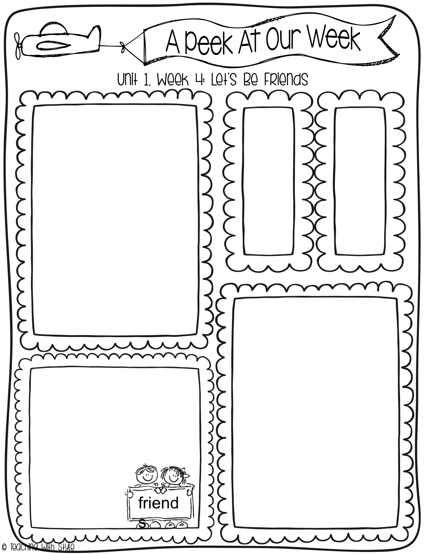
What we are learning!
Essential Question:
What do friends do together?
Comprehension Focus:
Ask and Answer Questions
Key Details
Word Work:
Short o, like in octopus
Alphabetical Order
Grammar:
Questions & Exclamations
Writing Trait:
Organization
Spelling Words
hop
top
log
hog
hot
lot
flip
black
they
too
HF
Words
fun
make
they
too
Vocabulary Words
cooperate: when you work together with someone and get something done.
relationship: when you have a connection with someone.
chore: a small job you must do.
collect: to gather things together.
deliver: when you take something to the person it belongs to.
Stories for the Week
Reading/Writing Workshop:
Toss! Kick! Hop!
Genre: Nonfiction
Literature Anthology:
Friends
Genre: Nonfiction
Big Book:
Friends All
Around

Slide 5
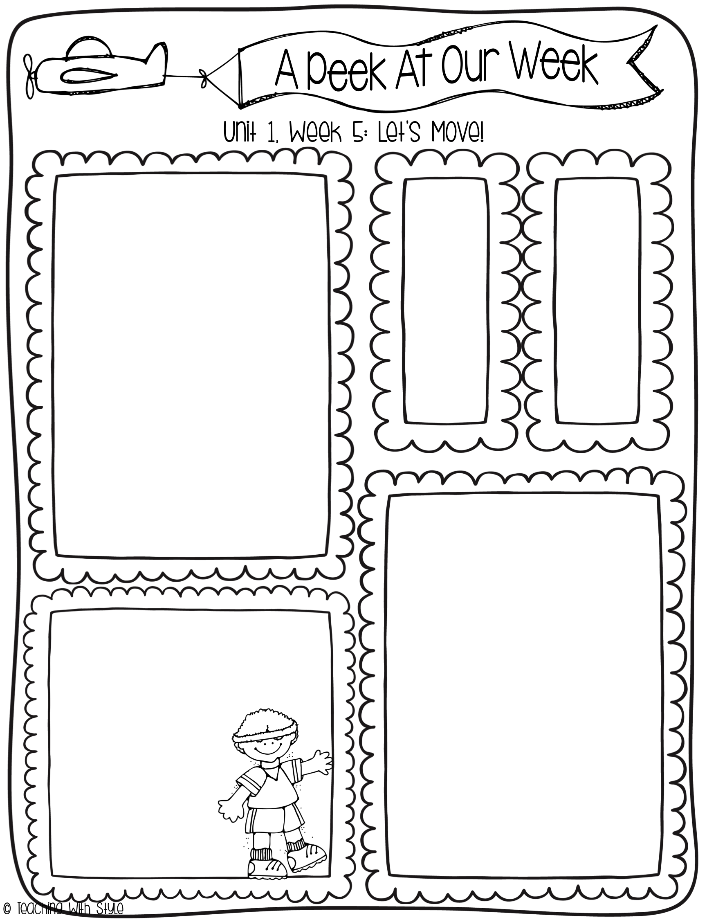
What we are learning!
Essential Question:
How does your body move?
Comprehension Focus:
Ask and Answer Questions
Key Details
Word Work:
R- and S- blends
Possessives
Grammar:
Writing Sentences
Writing Trait:
Organization
Spelling Words
spill
spin
grab
grass
drop
drip
hop
lot
two
move
HF
Words
jump
move
run
two
Vocabulary Words
exercise: activities you do with your body to stay healthy and get stronger.
physical: about the body
agree: when you and someone else have the same idea about something.
difficult: something that is hard to do and full of problems.
exhausted: someone who is very tired.
Stories for the Week
Reading/Writing Workshop:
Move and Grin!
Genre: Nonfiction
Literature Anthology:
Move It!
Genre: Nonfiction
Big Book: Move!

Slide 6
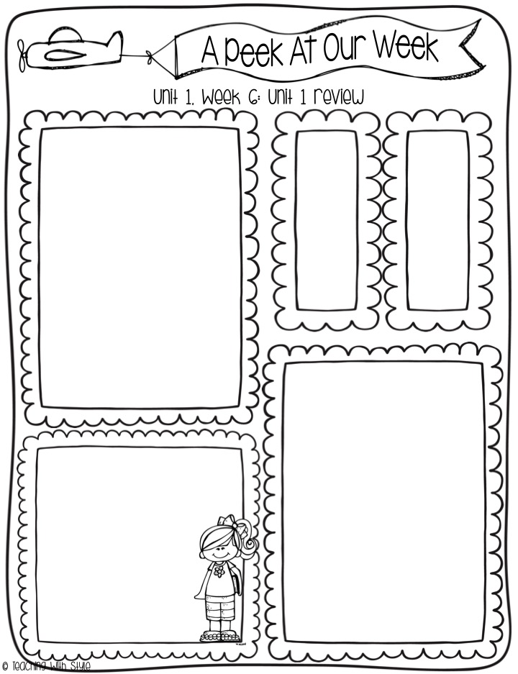
What we are learning!
Comprehension Review:
Ask and Answer Questions
Visualize
Key Details
Grammar Review:
Sentences
Word Order
Statements
Questions & Exclamations
Writing Sentences
Spelling Words
Review
HF
Words
Review
Structural Analysis Review
Inflectional Ending –s
Initial sound alliteration
Double final consonants
Plural nouns
Alphabetical Order
Possessives
Phonics Review
Short a, like in apple
Short i, the sound in insect
Contrast vowel sounds
L-blends
Short o, like in octopus
R- and S- blends

